Slide 1
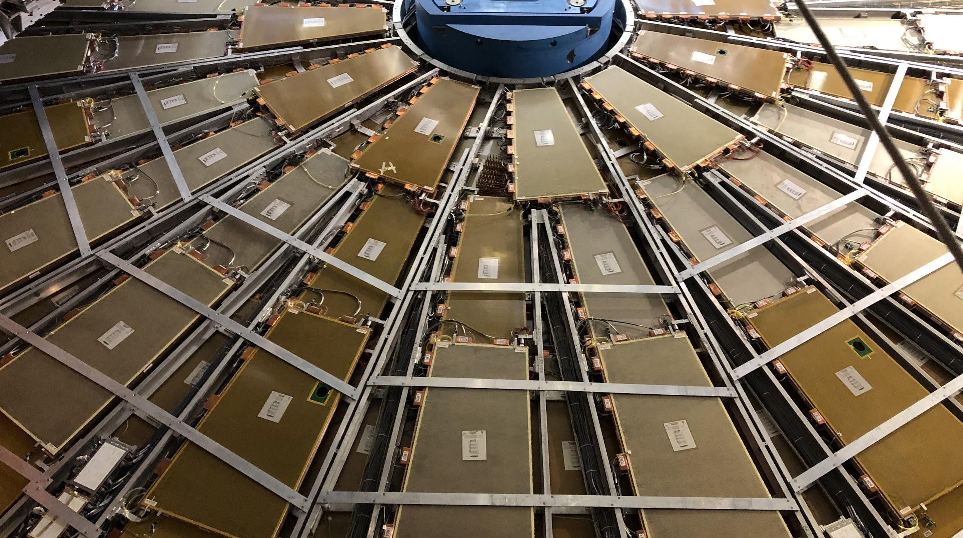

Maintenance Weekly
TileCal Op Meeting, 10 February 2022
Irakli Minashvili, Chris Thomas, Dawit Belayneh, Katie Hughes

Slide 2
Maintenance Updates from ELOG
EBC 58
Tried to start LVPS, unsuccessful
LBC Cooling
Temperature decreased as it was too hot in Rack Y0519A1
EBA 25
Power cycled

